Slide 1
Apple Stock Price Prediction
for the Next 30 Days

Slide 2
Mentor & Team Members
Mentor: Abisheka Kavuri
Team Members:
Tejaswi Wadekar
Khushboo Chhaje
Nitin Sangle
Moram Reddy
Himanshu kumar
Lokesh eyyuri
A P Aarunesh

Slide 3
Objective
To evaluate ARIMA, SARIMA, and XGBoost models for Apple stock price prediction and select accurate model.
To forecast the next 30 days of Apple’s stock closing price using the selected model.

Slide 4
Dataset Details
Dataset: Apple historical stock market data from 2012 to 2019
Period: 2012–2019
Columns: Date, Open, High, Low, Close, Adj Close, Volume
- Date : Trading date
- Open : Opening price of Apple stock for the day
- High : Highest price reached during the day
- Low : Lowest price reached during the day
- Close : Closing price of Apple stock for the day
- Volume : Number of shares traded on that day

Slide 5
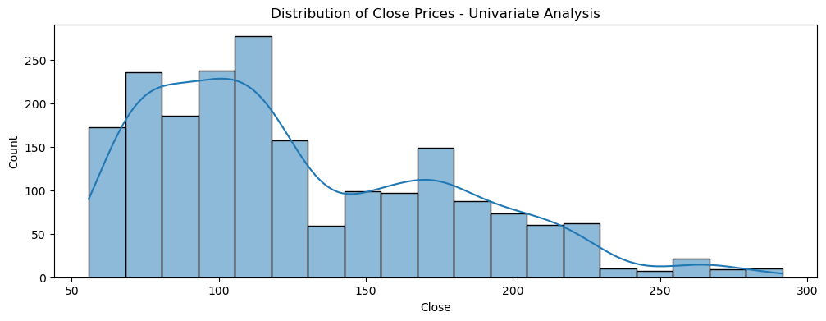
Exploratory Data Analysis (EDA) - Distribution of Close Prices
Observations:
The distribution of Close prices is right-skewed.
Most values lie between 75–150.
A few high peaks indicate volatility.
Inference:
Data is not normally distributed.
Frequent fluctuations indicate need for ARIMA-like forecasting models.

Slide 6
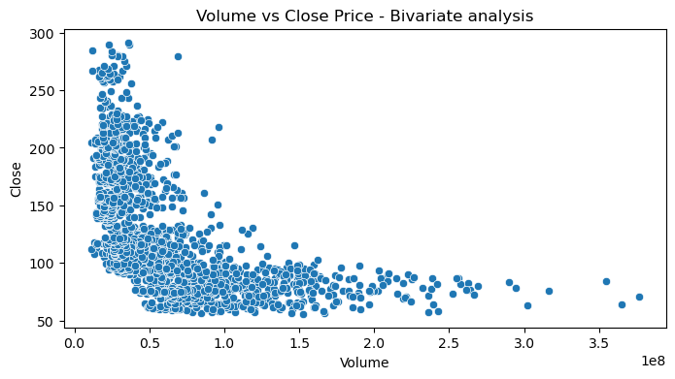
Volume vs Close Price
Observations:
There’s no strong linear relationship between Volume and Close price.
Higher volume generally appears when price drops.
Pattern is highly scattered and non-linear.
Inference:
Volume is not a useful predictor for Close price in simple linear form.
Univariate time series models (ARIMA) are more suitable.

Slide 7
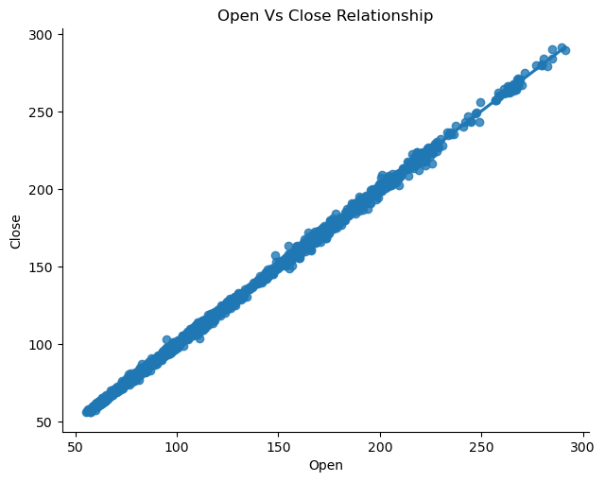
Open vs Close Relationship
Observations:
There is a strong positive linear relationship between Open and Close prices.
Open price increases, the Close price almost increases proportionally.
Inference:
This strong linear trend confirms that the stock price movement is consistent.
Such predictable behavior enhances the performance of forecasting models like ARIMA.

Slide 8
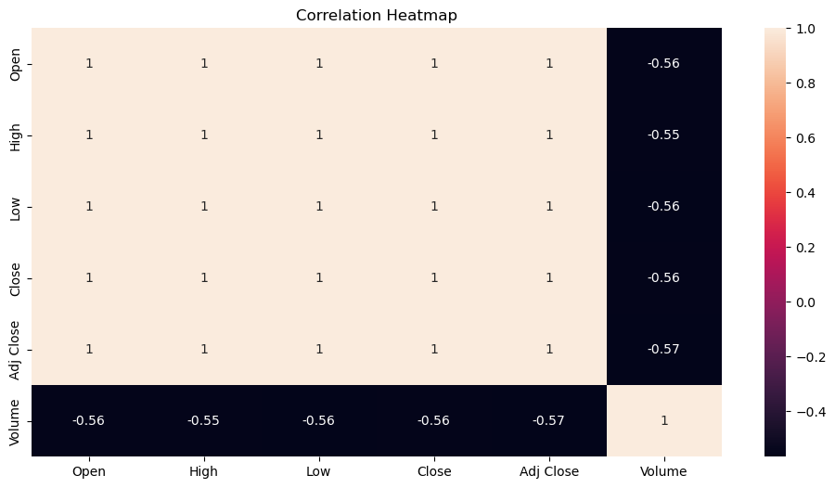
Correlation Heatmap
Observations:
Price-related features (Open, High, Low, Close) are perfectly correlated.
Volume shows moderate negative correlation with all price variables.
Inferences
Strong correlation among price variables indicates consistent price movement and trend, which is common in financial time-series data.
Volume behaves independently, showing that trading activity and price movements are not directly proportional.
Such correlation structure supports forecasting models like ARIMA/SARIMA, which perform well when data has trend and inter-feature dependency.

Slide 9
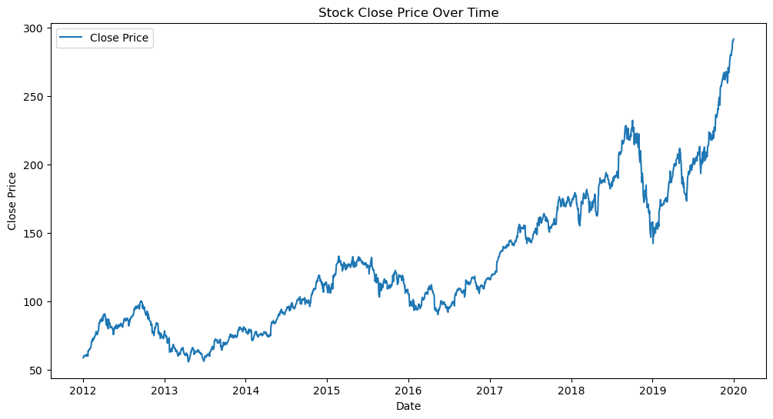
Stock Close Price over Time
Observations
The stock shows a clear upward trend from 2012 to 2020.
Prices experienced short-term fluctuations, including dips in 2013, 2016, and late 2018–2019.
Despite temporary declines, the overall price trend remains strongly positive, especially after 2019 where the price rises sharply.
Inferences
The strong upward trend indicates that the stock has grown consistently over time, making it suitable for forecasting using time-series models like ARIMA/SARIMA.
The presence of volatility shows market reactions to economic events, making 30-day forecasting meaningful for investors.
The long-term increase suggests high investor confidence and continuous growth in Apple's market value.

Slide 10
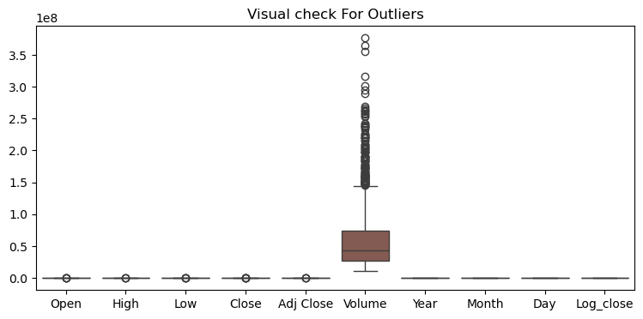
Visual Check for Outliers
Observations
Most numerical features (Open, High, Low, Close, Adj Close, Year, Month, Day, Log_Close) show very few or no outliers.
The Volume feature contains a large number of outliers, clearly visible as points far above the upper whisker.
This indicates that trading volume fluctuates a lot, especially during events like product launches, earnings announcements, or market-wide movements.
Inferences
The presence of many outliers in Volume suggests high volatility in trading activity, which is typical for large companies like Apple.
Since Volume does not directly impact the ARIMA model(which focuses on Close Price trend), these outliers do not negatively affect forecasting performance.
The remaining features are stable and do not require additional outlier treatment.

Slide 11
Communicate Findings and Insights from EDA
Close and Open price has highly correlated
Volume has weaker correlation with price
Some outliers is found in volume but Its common.
Price generally increased over time , but with volatility.
Data is now ready for Feature Engineering

Slide 12
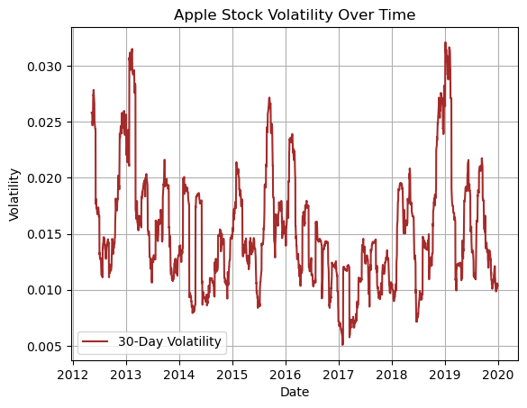
Apple Stock Volatility Over Time
Observations
The 30-day rolling volatility shows regular fluctuations, indicating frequent short-term price movements in Apple stock.
Certain periods (e.g., 2013, 2015, and late 2018–2019) show significant spikes, meaning the stock experienced higher uncertainty or rapid price swings.
Periods with lower volatility indicate more stable price behavior.
Inferences
Volatility spikes often align with major market events, earnings announcements, or global economic changes.
Understanding volatility helps in forecasting because higher volatility increases unpredictability, making it important for selecting forecasting models.
Despite fluctuations, volatility remains within a reasonable range for a tech stock, indicating Apple’s long-term stability.

Slide 13
Data Preprocessing
Data Preprocessing Steps:
Checked dataset for missing values and inconsistencies.
Converted Date column into datetime format and used it as index.
Extracted additional time-based features: Year, Month, Day.
Performed visual outlier check using boxplots.
Applied transformations (like log) wherever needed to stabilize variance.
Split the dataset into training and testing sets.

Slide 14
Feature Engineering
1. Date Column Breakdown
Extracted Year, Month, and Day from the Date column
Helped understand seasonality and monthly trends
2. Log Transformation
Applied Log transformation on Close Price (Log_Close)
Reduced skewness
Made the data more suitable for time-series models (ARIMA/SARIMA)
3. Moving Averages
Created MA7, MA20, MA30
Helped capture trend & support/resistance levels
Useful for understanding long-term behavior
4. Volatility Feature
Created 30-Day Rolling Volatility
Helped identify high-risk and low-risk periods in the stock
5. Outlier Detection (Visual + Statistical)
Boxplot used to detect outliers, mostly in Volume
Outliers kept as-is since they represent real market fluctuations

Slide 15
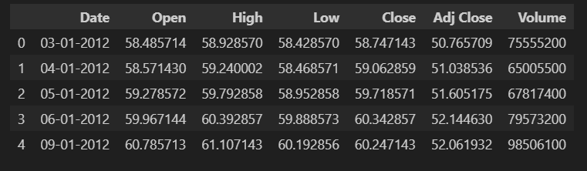
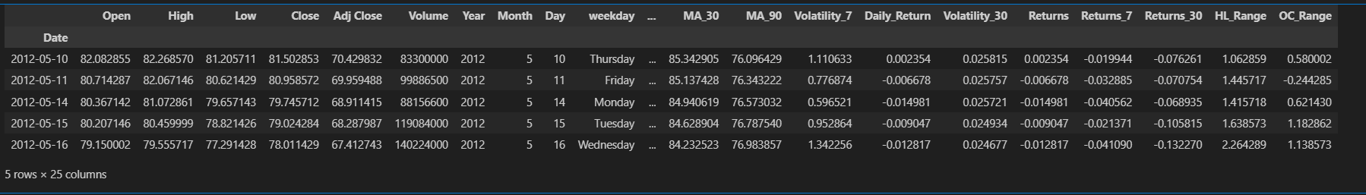
Comparison
Before Feature Engineering The dataset originally contained basic stock attributes such as Open, High, Low, Close, Adj Close, and Volume. | After Feature Engineering New features were created to improve forecasting accuracy: Date-based Features: Year, Month, Day, Weekday Moving Averages: MA_7, MA_30, MA_90 (captures trend) Volatility Features: Volatility_7, Volatility_30 Returns Features: Daily_Return, Returns_7, Returns_30 Range Features: High-Low Range, Open-Close Range
Purpose: These engineered features help the model understand trends, seasonal patterns, volatility, and price behavior more accurately.

Slide 16
Model Selection Approach
Why These Models?
To achieve accurate 30-day forecasting, three different approaches were used:
ARIMA
Best for time-series with trend patterns
SARIMA
Captures both trend + seasonality
XGBoost
Machine Learning model that learns non-linear patterns
Using these three models helps compare statistical vs. ML-based forecasting.

Slide 17
ARIMA Model
ARIMA (AutoRegressive Integrated Moving Average)
Model used to capture trend-based behavior in the stock price.
Model parameters (p, d, q) selected using ACF/PACF analysis.
Trained on historical Close Price values.
Generated 30-day future forecast.
Inferences
ARIMA captured long-term trend well.
Slightly higher error compared to SARIMA.

Slide 18
SARIMA Model
SARIMA (Seasonal ARIMA)
Extended ARIMA with seasonal terms.
Seasonal order (P, D, Q, S) added to capture repeating stock patterns.
Performed well in modeling short-term seasonal fluctuations.
Inferences
Produced better accuracy than ARIMA.
Represented seasonality effectively.

Slide 19
XGBoost Model
XGBoost Regressor
Machine-learning approach for stock forecasting.
Used multiple features: Open, High, Low, Close, Adj Close, Volume, Year, Month, Day.
Captures complex non-linear relationships between features.
Inferences
Performed poorly compared to ARIMA/SARIMA.
Higher error due to non-stationary nature of stock prices.

Slide 20
Model Evaluation Table (MSE & MAE)
Model | MAE | MSE | Conclusion
ARIMA | 9.85 | 13.21 | Good trend prediction but not the best.
SARIMA | 7.83 | 115.56 | Most accurate model for 30-day forecasting.
XGBoost | 19.26 | 925.85 | High error; not ideal for time series.

Slide 21
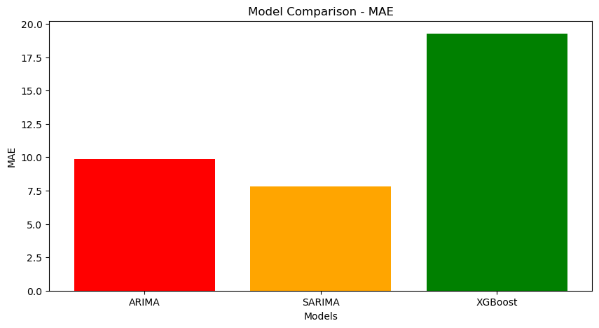
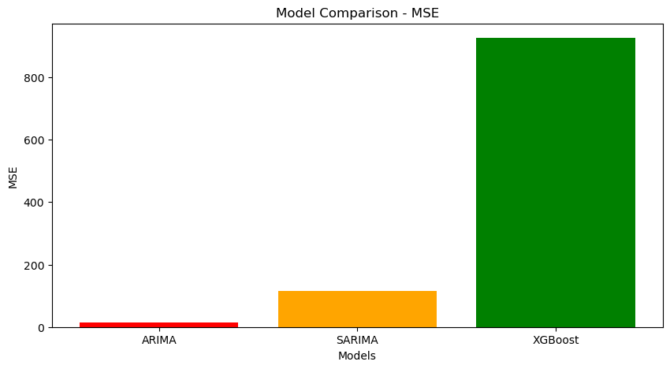
Model Evaluation – MSE & MAE Comparison
Key Observations:
SARIMA has the lowest MAE (7.83) → meaning it predicts closest to actual values.
ARIMA has very low MSE, but slightly higher MAE than SARIMA.
XGBoost performs the worst (highest MSE & MAE).
Conclusion:
SARIMA is the best-performing model for forecasting Apple’s stock prices because it captures trend + seasonality more accurately.
ARIMA performs reasonably well but misses seasonal patterns.
XGBoost is not suitable for this time-series dataset due to lack of sequential learning.

Slide 22
Best Performing Model – SARIMA
Why SARIMA is the Best Model?
SARIMA achieved the lowest MAE = 7.83, meaning predictions are closest to actual prices.
It effectively captures trend + seasonality, which is important in stock time-series data.
Produces stable and smoother forecasts compared to ARIMA and XGBoost.
Handles time dependency better than machine learning models.

Slide 23
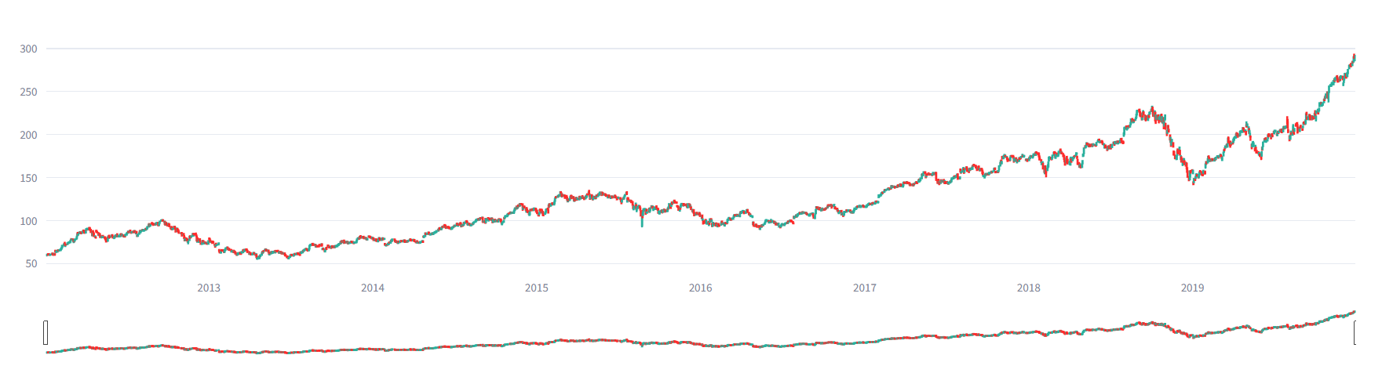
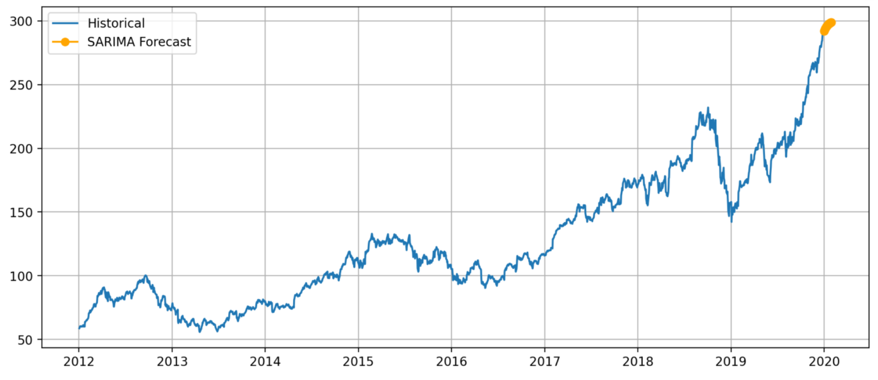
Model Visualization and Prediction Output
Candlestick Chart – Stock Price Movement Shows daily Open, High, Low, and Close values of Apple stock. Helps visualize market trends, volatility, and price fluctuations. Useful for identifying bullish and bearish phases in the selected time period. | SARIMA Forecast – Next 30 Days Prediction Forecasts future stock prices using the SARIMA model. Orange points represent predicted closing prices for the next 30 days. SARIMA chosen as best model due to lowest MAE and stable prediction pattern.

Slide 24
Challenges Faced During the Project
Required careful preprocessing to ensure model accuracy.
Choosing the best model based on evaluation metrics (MSE & MAE) was challenging.
Understanding parameters (p, d, q, P, D, Q) and seasonal components was difficult initially.
Integrating complex forecasting logic into Streamlit caused errors.
MSE & MAE were giving different rankings.
Needed clear understanding of which metric to rely on (MAE for time-series).

Slide 25
Thank You
Thank you for giving me the opportunity
to present my project.

